Slide 1
Basic CNN

Slide 2

CNN
http://parse.ele.tue.nl/cluster/2/CNNArchitecture.jpg

Slide 3
CNN
Convolution
Non-Linear(Relu for example)
Pooling or sub sampling( Max Pooling for example)
Classification (Full connected layer)

Slide 4
Convolutional Layers

Slide 5
Input Image, Kernel(Filter),
Feature Map(Output Volume)

Slide 6
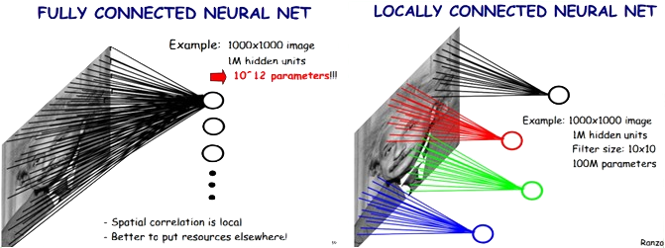
Locally Connected Features
https://ireneli.eu/2016/02/03/deep-learning-05-talk-about-convolutional-neural-network%EF%BC%88cnn%EF%BC%89/

Slide 7

An Image is a 2D matrix

Slide 8
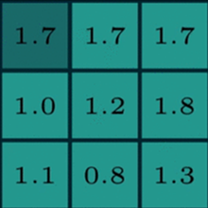
Two maxtrics interact
Reception field
A kernel(filter, neuron)
Numbers: weights

Slide 9
Two maxtrics interact
Sliding

Slide 10
Two maxtrics interact

Slide 11
Two maxtrics interact

Slide 12

Kernel(Filter)
255
200
0
*
=
155
55
35
???
55
10
5

Slide 13
Two maxtrics interact

Slide 14
Two maxtrics interact

Slide 15
Two maxtrics interact

Slide 16

Generate a new image
32 X 32 X 3
5x5x3
Feature Map
(Activation Map)
(Output Volume)
28 X 28 X 3

Slide 17

Generate a new image

Slide 18
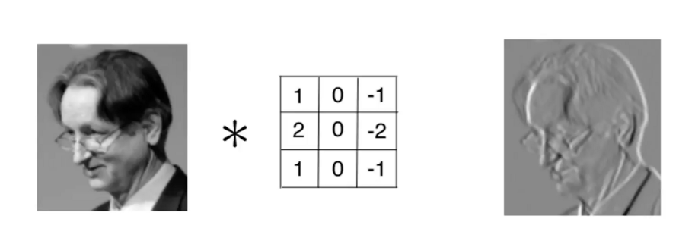
Kernel is used as Feature Detector

Slide 19
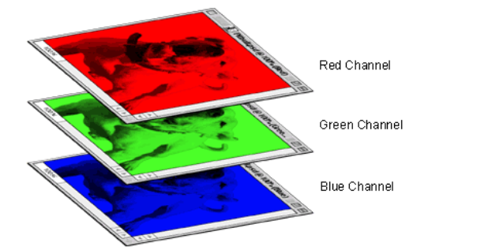
A colored image is 3 x 2d matrix

Slide 20
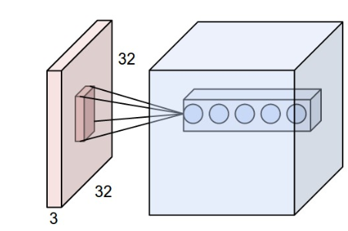
Convolve in 3D(32x32x3) Input Image
Every kernel should be (mxmx3) size
The kernel slide over the xy plane with same depth(3)
The product of 3D image and 3D kernel is still a 2D plane.
The output volume is the stack of all planes created by all kernels.
In this example the output volume is nxnx5 dimension.

Slide 21
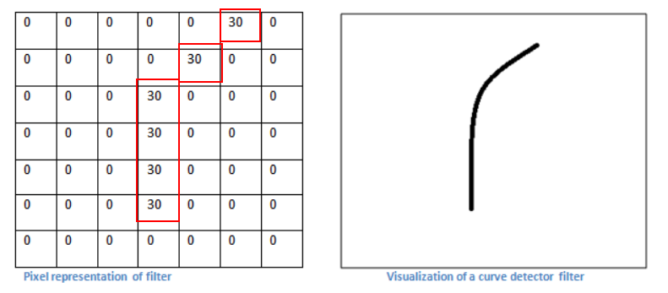
A filter is just a feature identifier

Slide 22
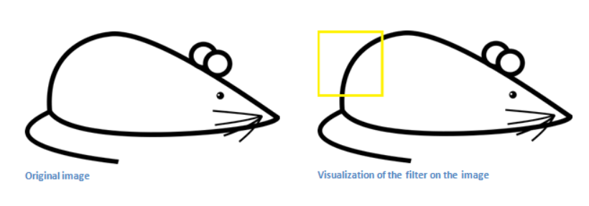
Filter on a part of an image

Slide 23
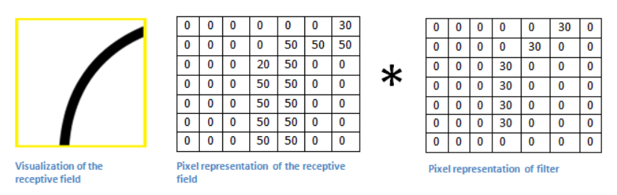
Just matrics multiplication

Slide 24
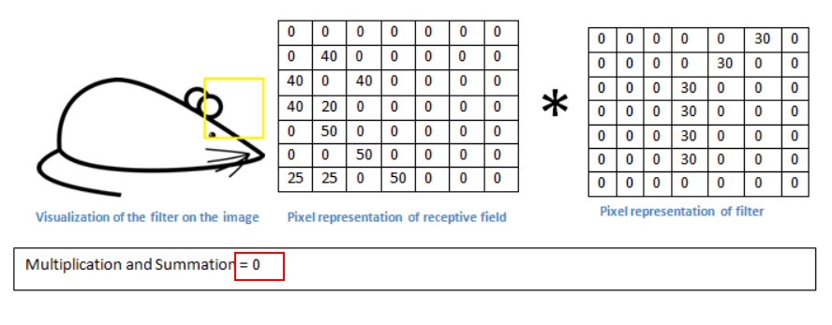
Without the feature

Slide 25
Filters = Feature Detectors
A filter for a unique feature.
Millions of filters in a convolutional network
Higher number ‘fires’ means the feature is detected
So many different feature detectors for different features.

Slide 26
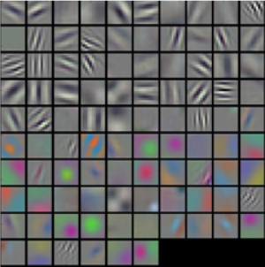
Filters = Feature Detectors

Slide 27
Layers that extract features
Earlier layers extract low level object like curves and edges.
We need the network to recognize higher level features such as hands, or paws or ears.
Different neurons in each layer is representing a feature to detect different objects, like faces, texts.

Slide 28
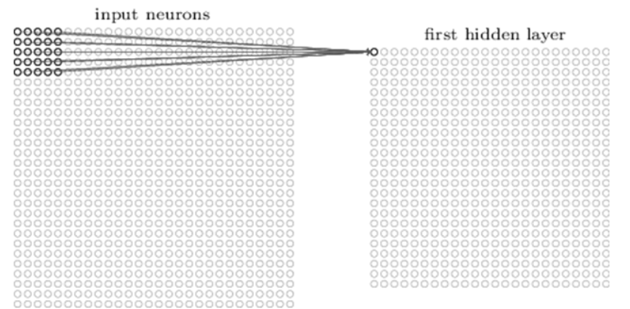
A first layer neuron:
The number of weight is 5x5x1(Kernel dimension ) + 1 bias.

Slide 29
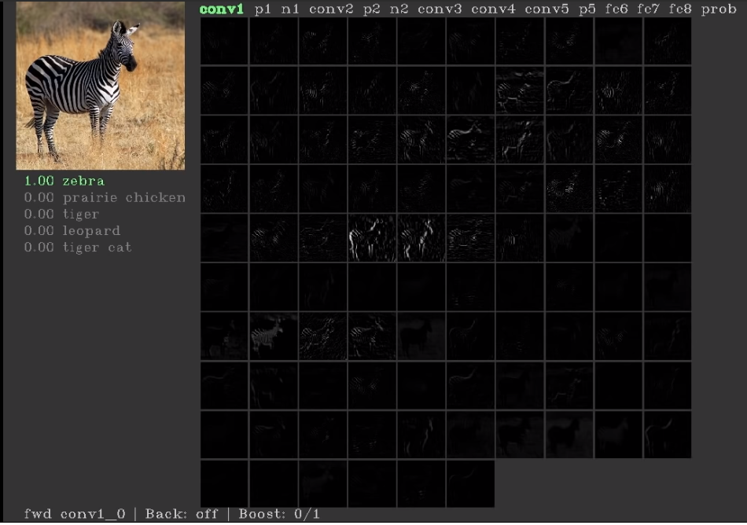
First layers’ neurons for basic features(conv1)

Slide 30
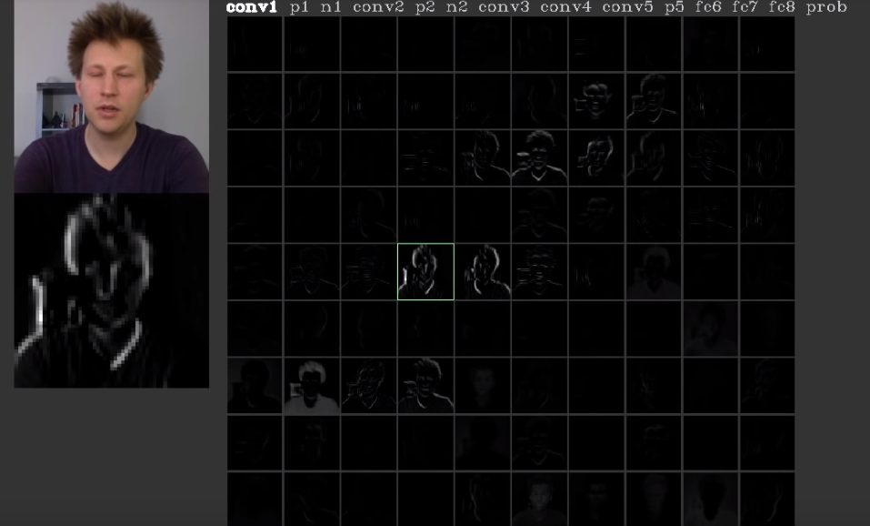
First layers’ neurons for basic features(conv1)

Slide 31
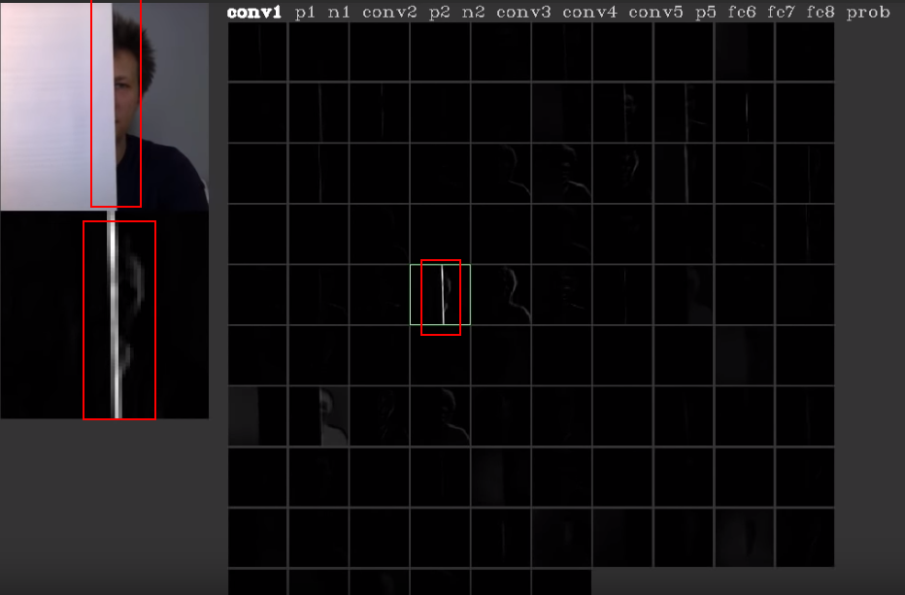
The neuron is for edges

Slide 32
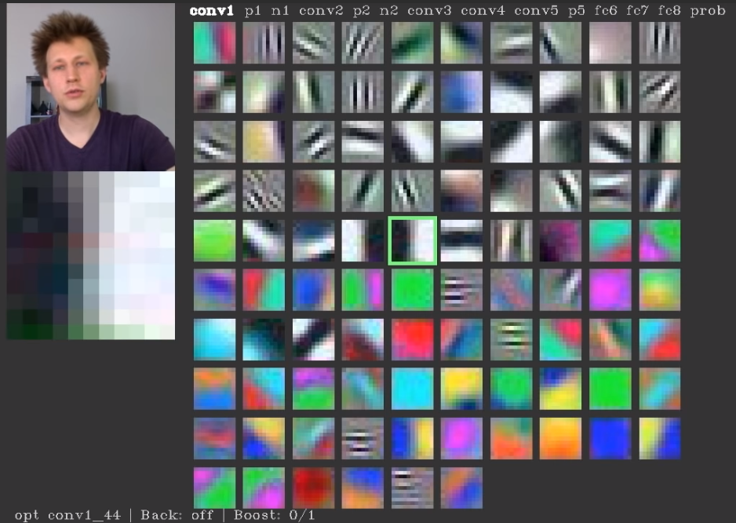
Every neuron is looking for something

Slide 33
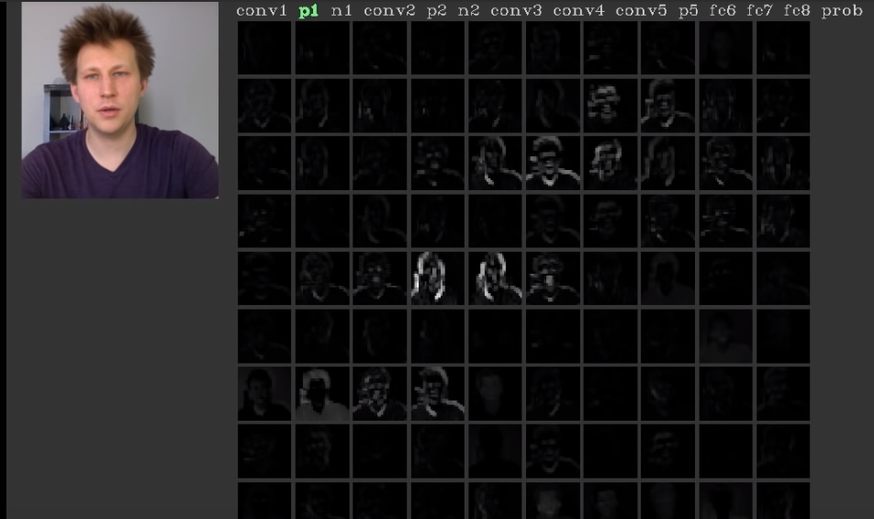
Pooling layer

Slide 34
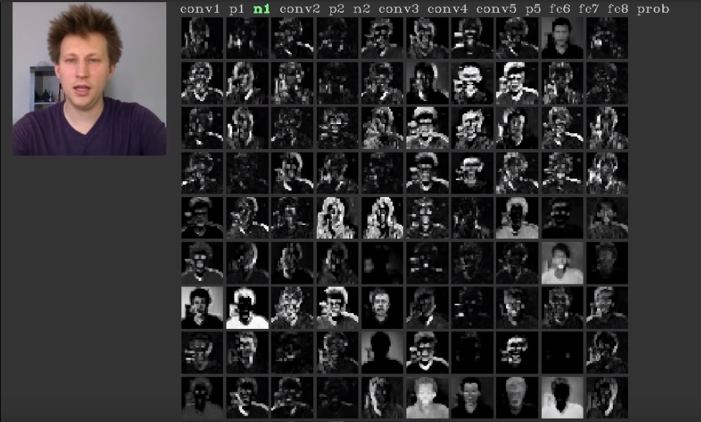
Normalise layer

Slide 35
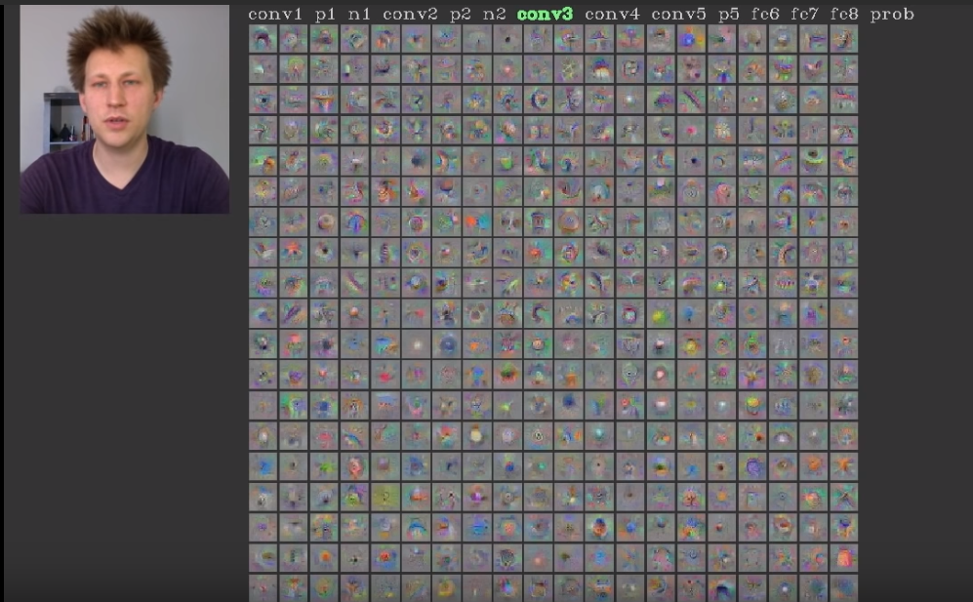
Con3 layer

Slide 36
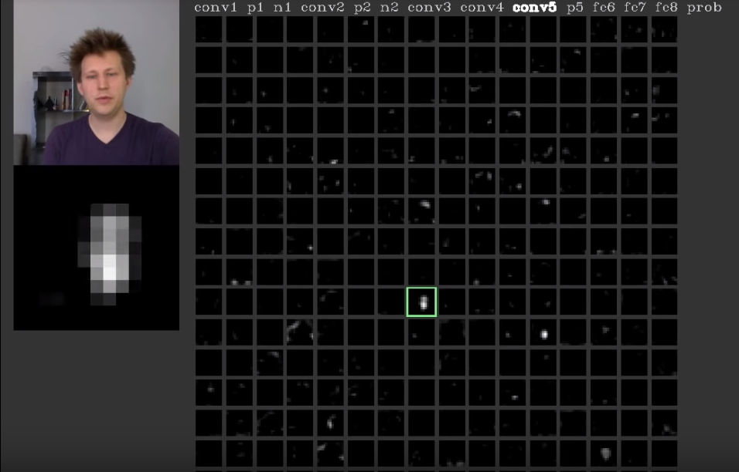
Neuron in con5 layer is for faces

Slide 37
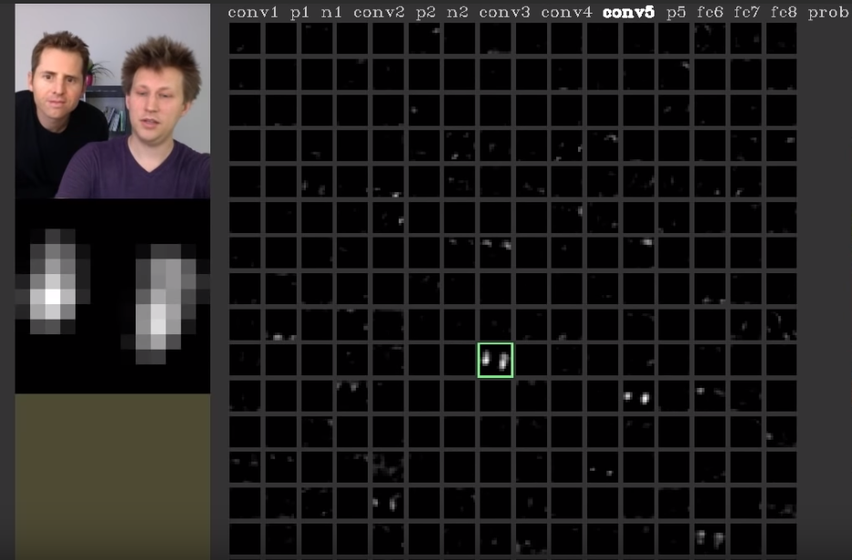
Neuron in con5 layer is for faces

Slide 38
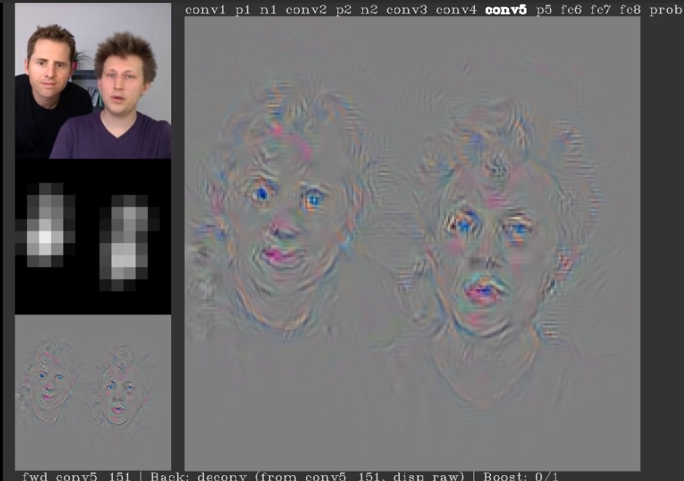
Neuron in con5 layer is for faces

Slide 39
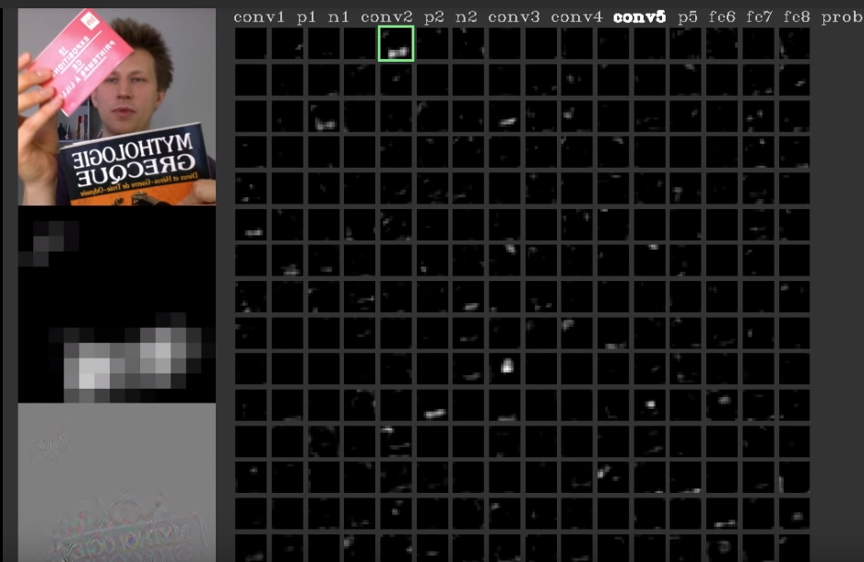
Neuron in con5 layer is for printed texts

Slide 40
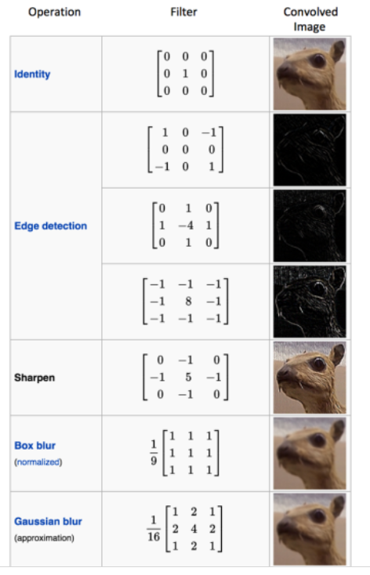
Different filters can detect different features from an image

Slide 41
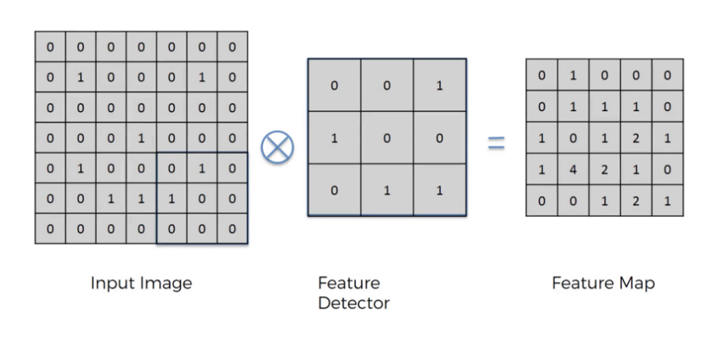
Convolution

Slide 42
Convolution
Convolution is a mathematical operation on two functions
To produce a third function that expresses how the shape of one is modified by the other.
The term convolution refers to both the result function and to the process of computing it. Convolution is similar to cross-correlation
Convolution preserves the spatial relationship between pixels by learning image features using small squares of input data.

Slide 43
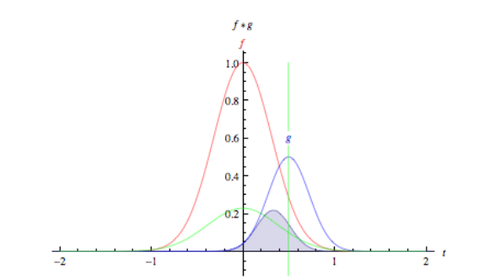
Convolution

Slide 44

Convolution

Slide 45

Two images convolve

Slide 46
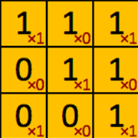
filter‘ or ‘kernel’ or ‘feature detector

Slide 47
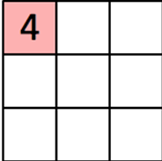
Convolved Feature’ or ‘Activation Map’ or the ‘Feature Map‘

Slide 48

Convolution operation captures the local dependencies in the original image

Slide 49
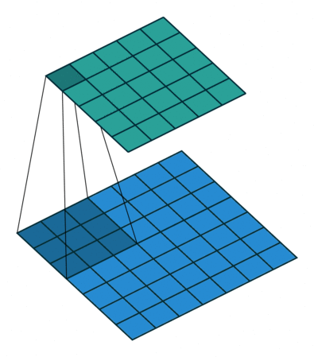
Convolution in Action
https://github.com/vdumoulin/conv_arithmetic

Slide 50
Relu Layers

Slide 51
Relu Layers
Added after every convolutional layer.
As non-linear layer(activation layer)
Since all conv layers are doing linear computing.
Used to use tanh and sigmoid.
Relu is faster.
f(x) = max(0, x)

Slide 52
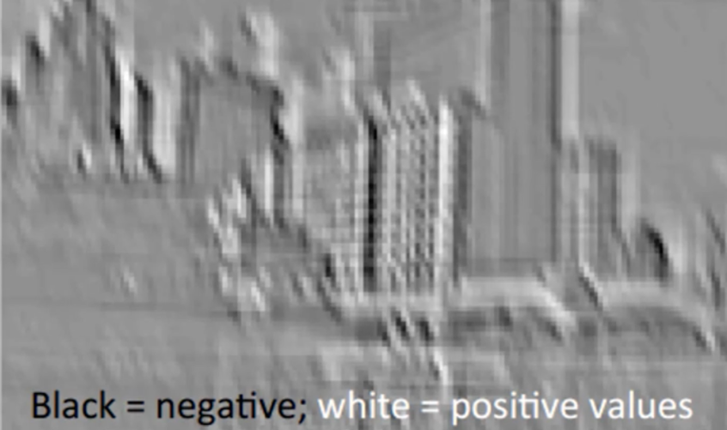
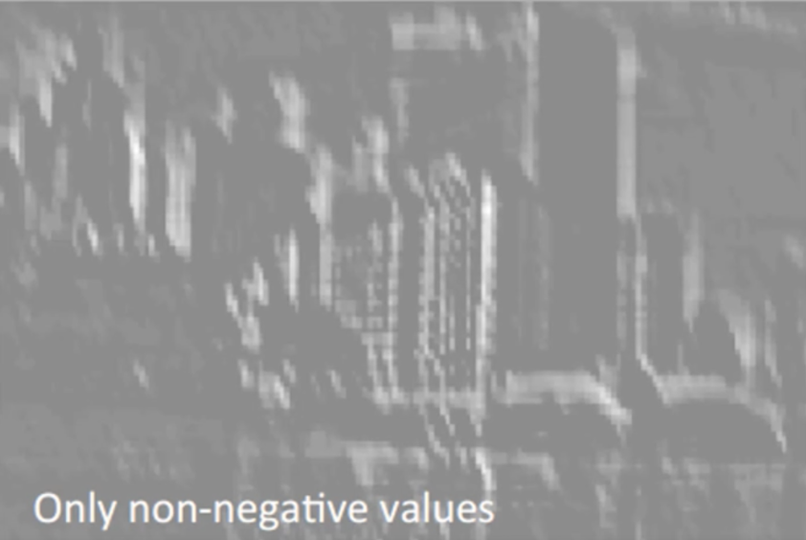
Relu, delete negative(black)

Slide 53
Size of featured map
Depth
Stride
Zero-padding
https://github.com/vdumoulin/conv_arithmetic

Slide 54
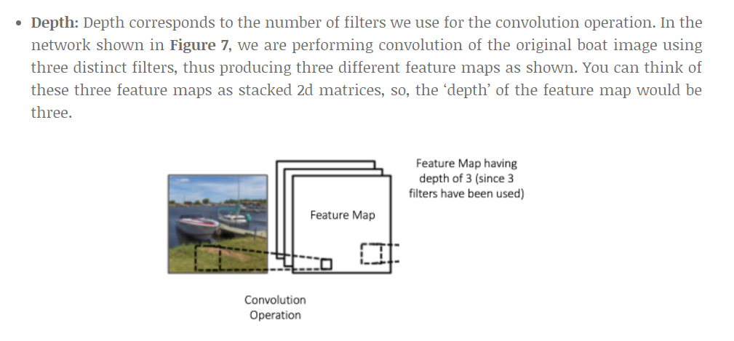
Depth(Number of filters)
https://github.com/vdumoulin/conv_arithmetic

Slide 55
Stride
How many cell we move the kernel.
Bigger stride, smaller output image.
Usually less than 3.

Slide 56
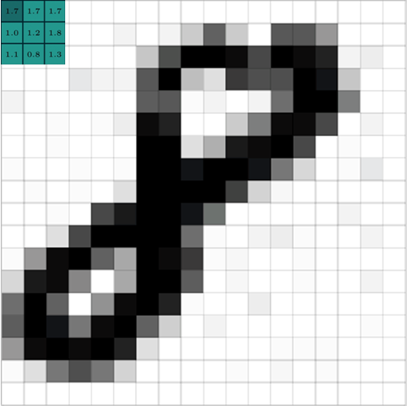
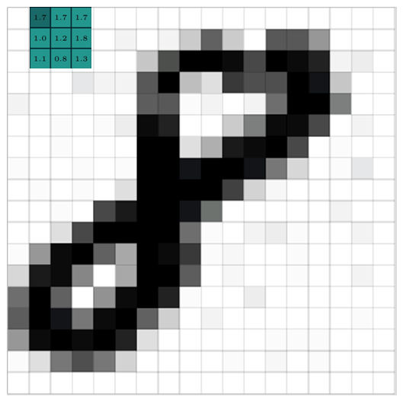
Stride = 1

Slide 57
Stride = 2

Slide 58
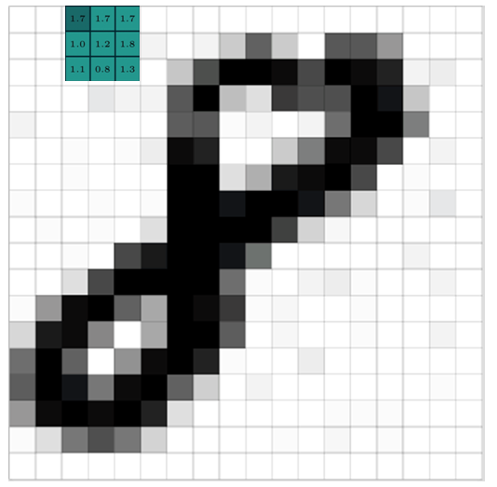
Stride = 1

Slide 59
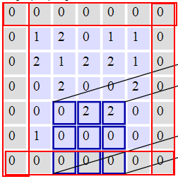
Zero Padding
Pad cells around a map
Could be any size
Usually 0-2
Purpose is to keep the output map the same dimension as input map.

Slide 60
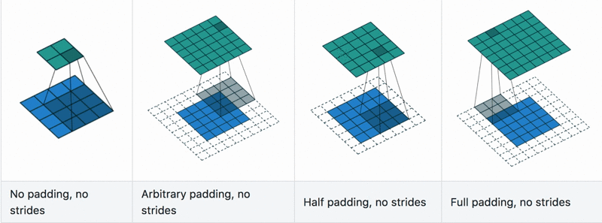
Convolution with padding in Action
https://github.com/vdumoulin/conv_arithmetic

Slide 61
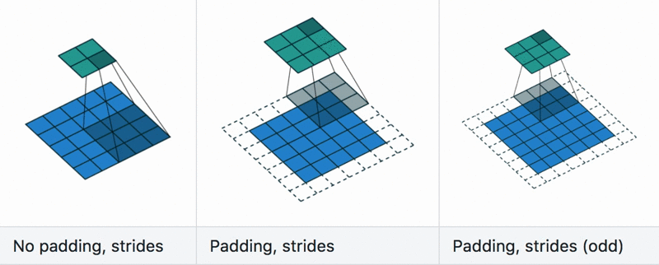
Convolution with stride in Action
https://github.com/vdumoulin/conv_arithmetic

Slide 62
Convolve in action

Slide 63
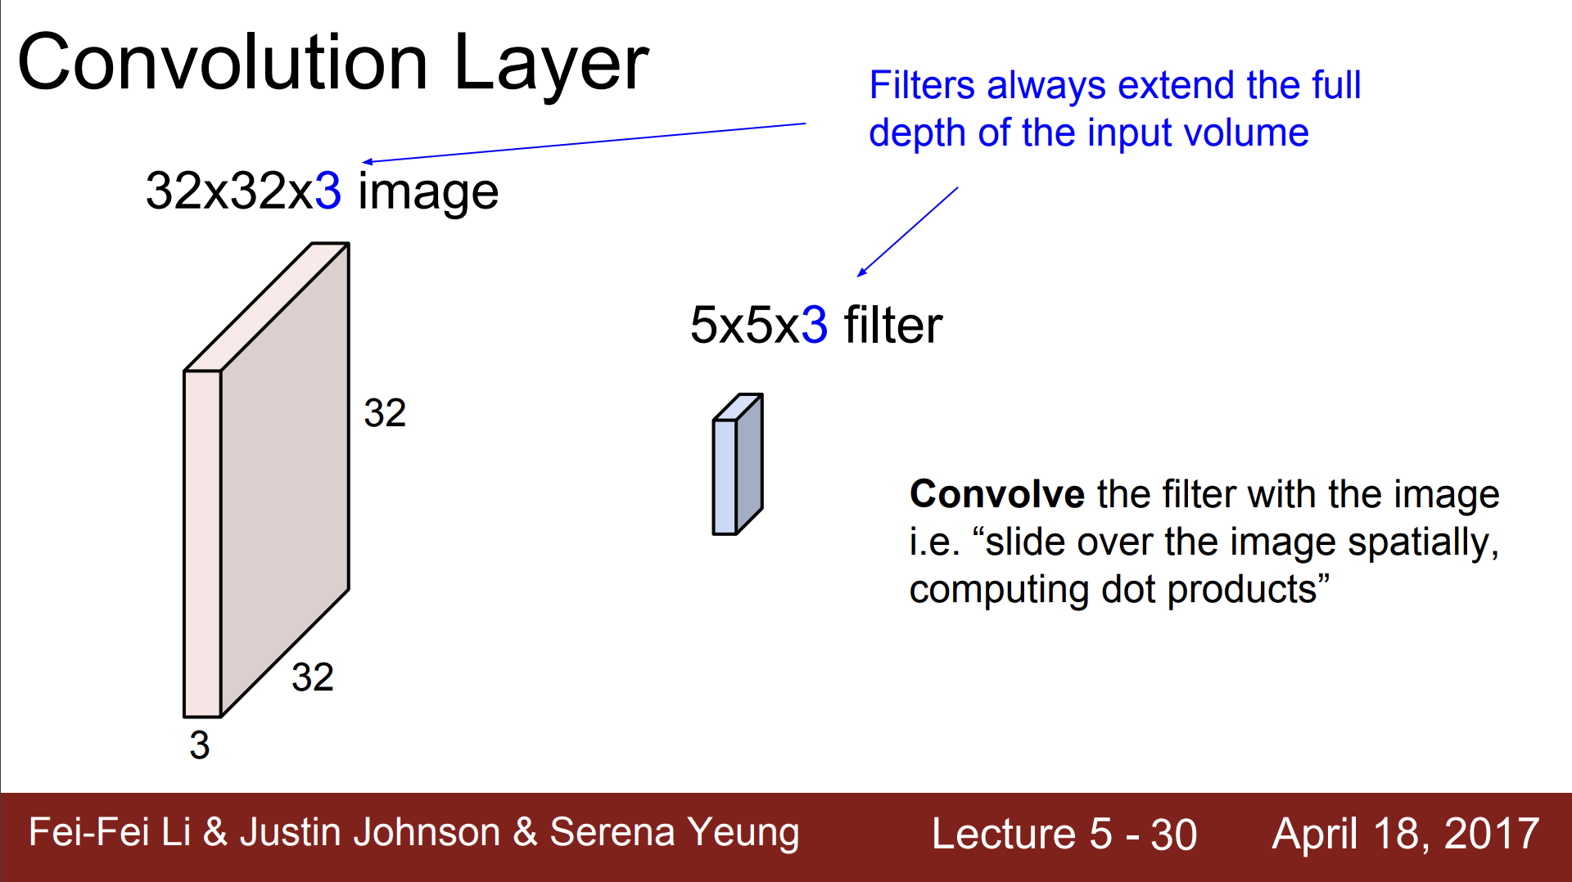

Slide 64
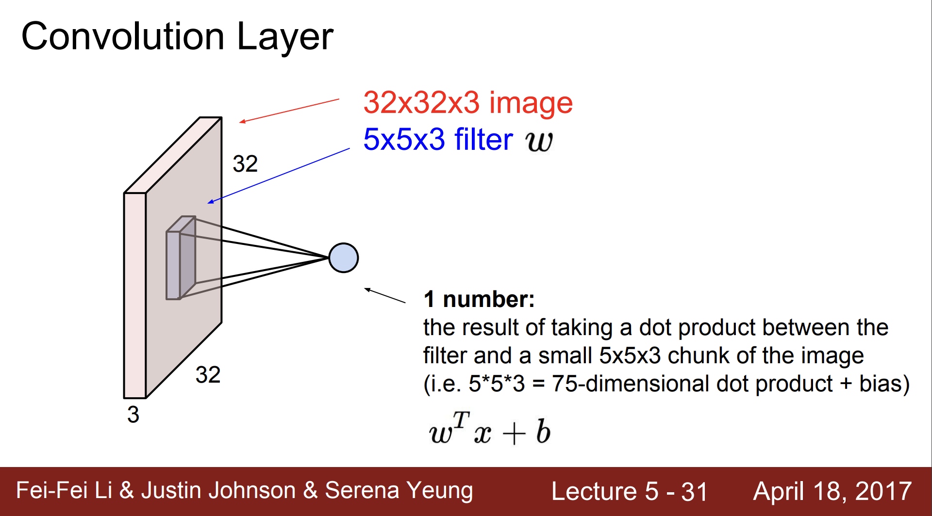

Slide 65
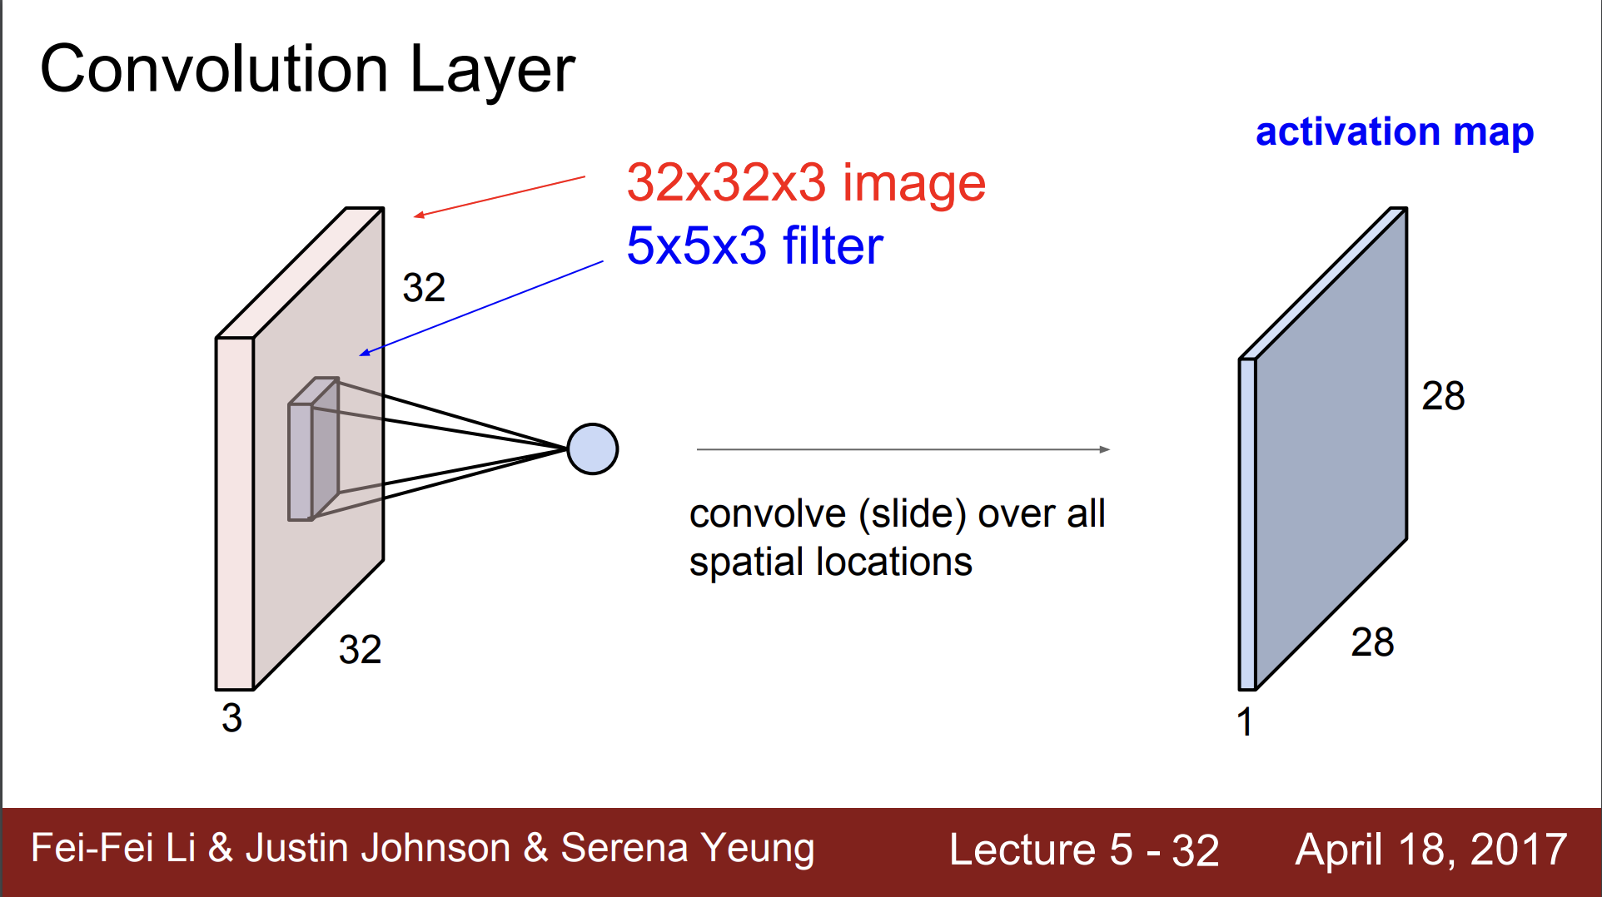

Slide 66
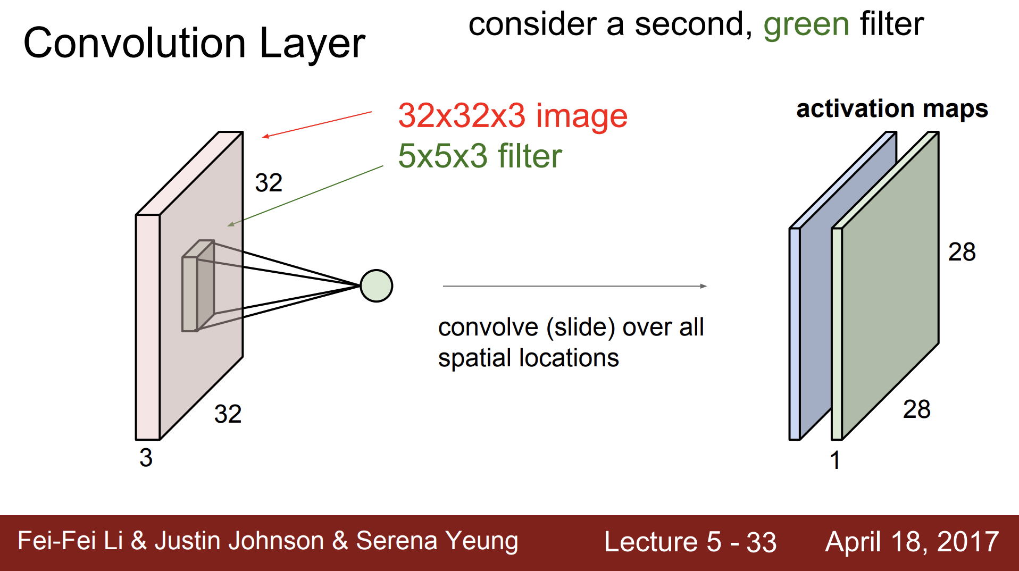

Slide 67
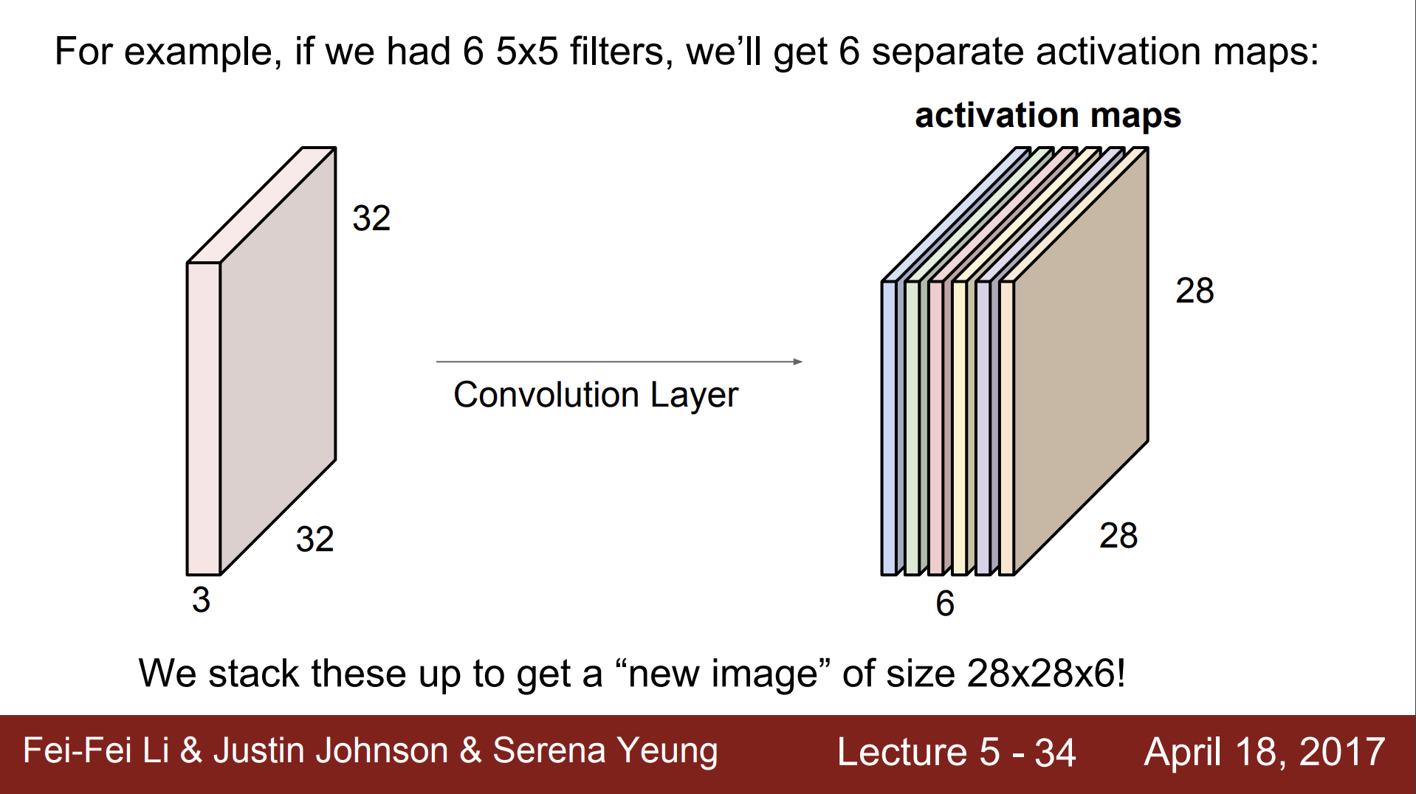

Slide 68
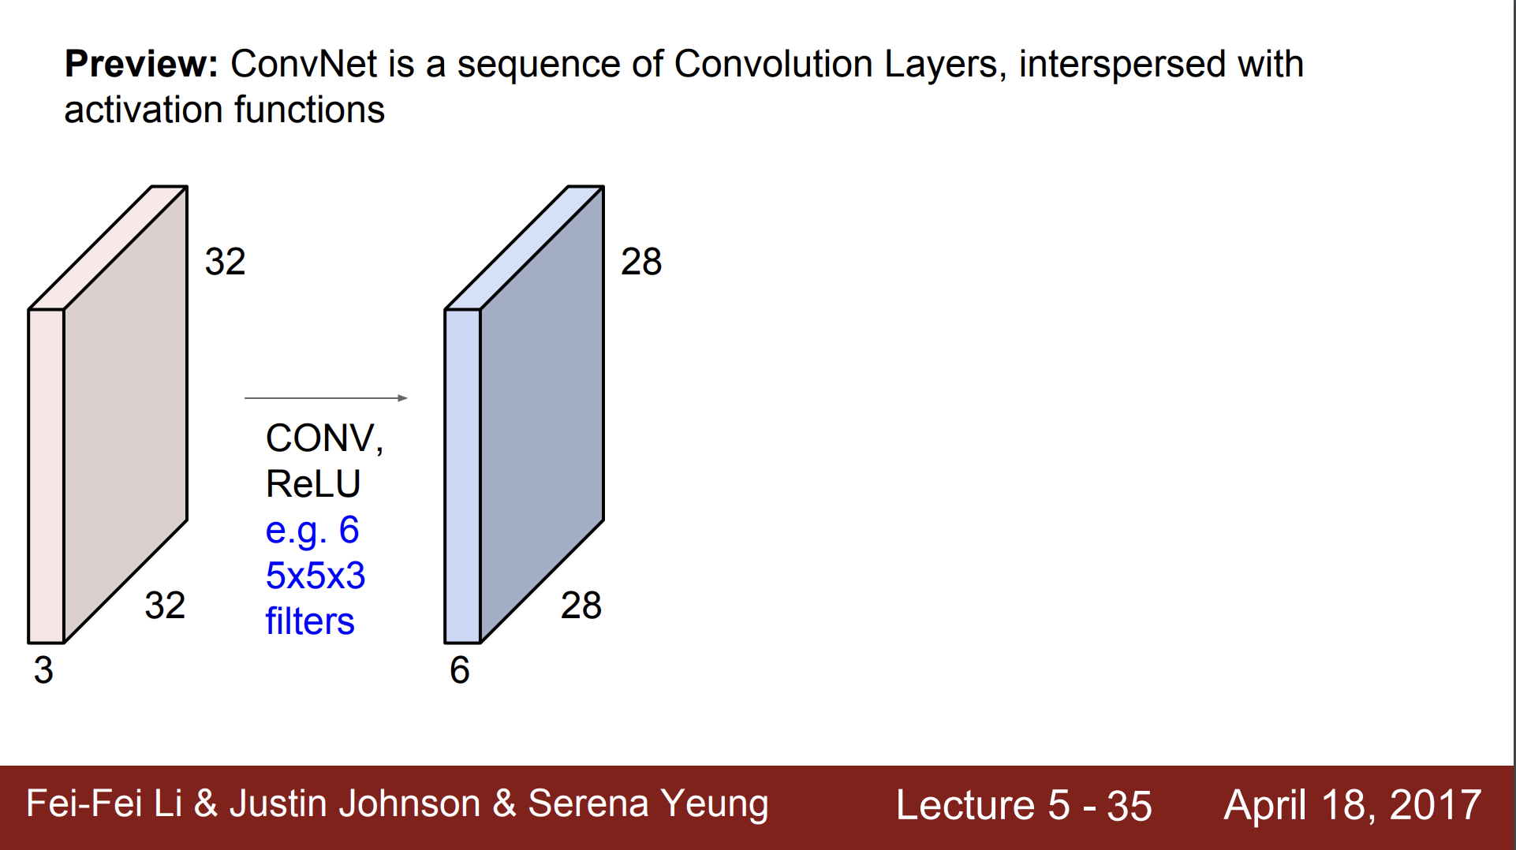

Slide 69
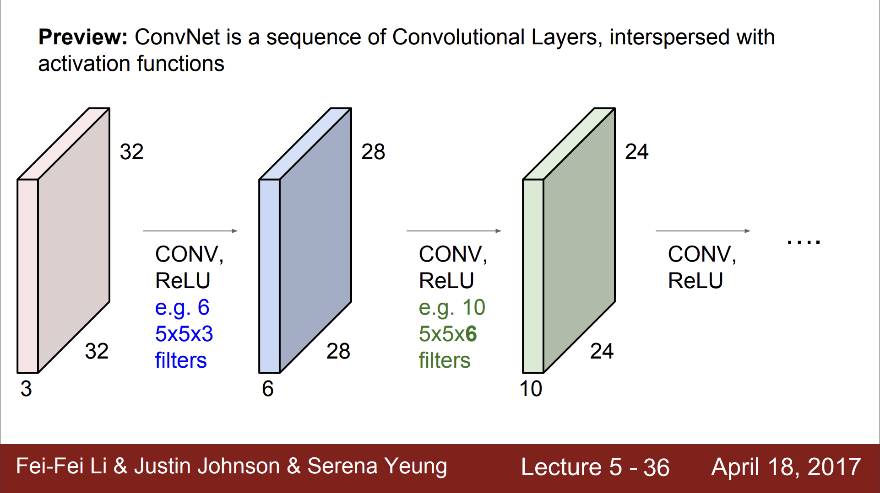

Slide 70
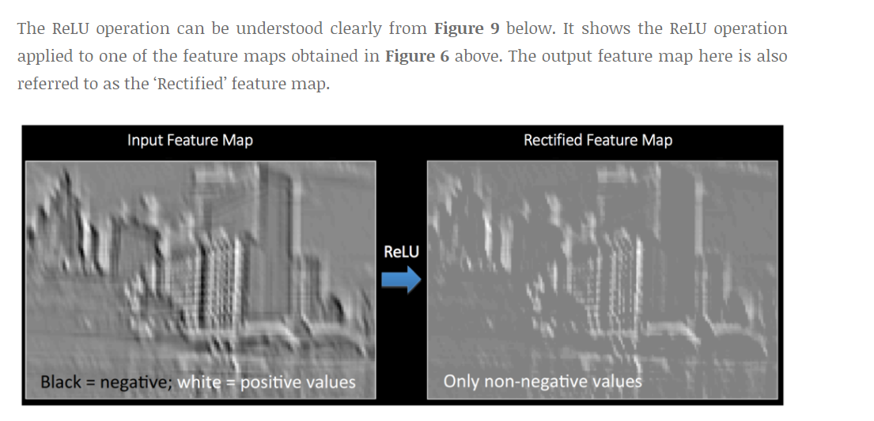
Relu

Slide 71
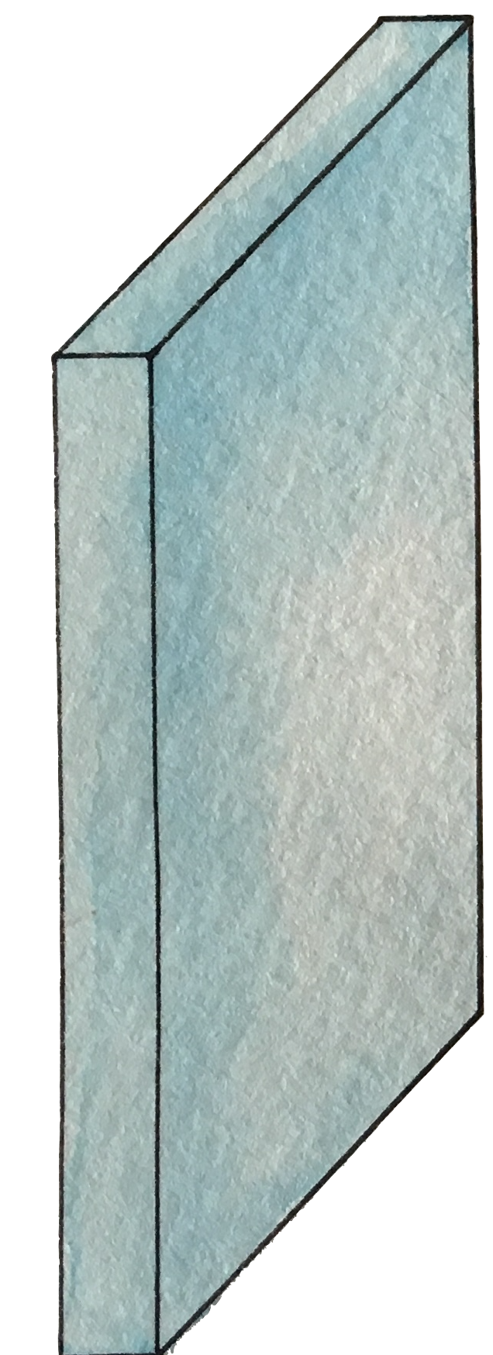
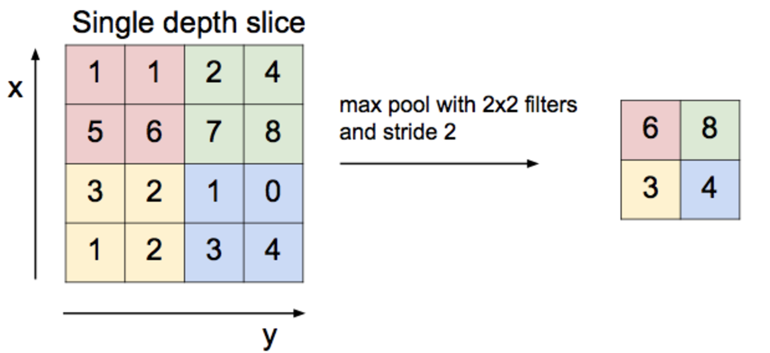
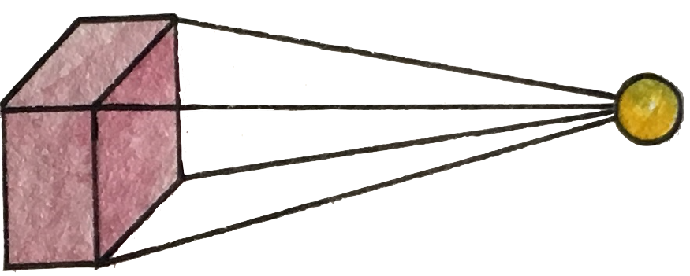
Max pooling

Slide 72
Pooling Layer

Slide 73
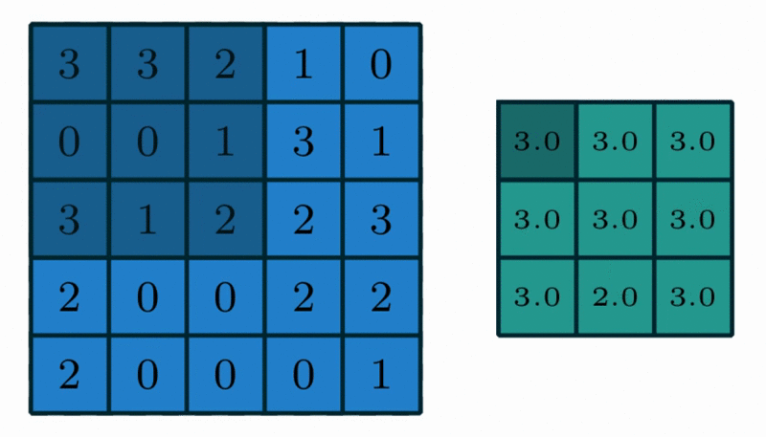
Max Pooling in Action
https://github.com/vdumoulin/conv_arithmetic

Slide 74
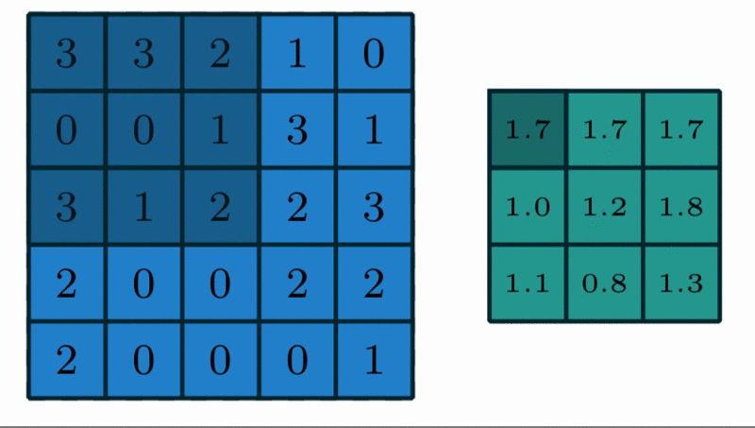
Avg Pooling in Action
https://github.com/vdumoulin/conv_arithmetic

Slide 75

Max Pooling in Action

Slide 76

Max Pooling in Action (with padding)

Slide 77

Max Pooling with depth of 3

Slide 78

Pooling

Slide 79
Reaons of pooling
Makes the input smaller and more manageable
Reduces the number of parameters and computations in the network,
Makes the network invariant to small transformations, distortions and translations in the input image
Small distortion in input will not change the output of Pooling – since we take the maximum / average value in a local neighborhood).
Helps us arrive at an almost scale invariant representation of our image
We can detect objects in an image no matter where they are located.

Slide 80

Fully Connected
https://github.com/vdumoulin/conv_arithmetic

Slide 81
Fully Connected
The Fully Connected layer is a traditional MLP that uses a softmax activation function in the output layer
The purpose of the Fully Connected layer is to use these features for classifying the input image into various classes based on the training dataset
The sum of FC layers’ probability is 1 ensured by Softmax to form a probability distribution.
https://github.com/vdumoulin/conv_arithmetic

Slide 82

實際運算，使用Im2col

Slide 83

CNN

Slide 84


Slide 85

Visualize the CNN

Slide 86


A hand-written digit ‘8’

Slide 87

A hand-written digit ‘8’

Slide 88

A hand-written digit ‘8’

Slide 89


A hand-written digit ‘8’

Slide 90


A hand-written digit ‘8’

Slide 91


Simple CNN

